Slide 1
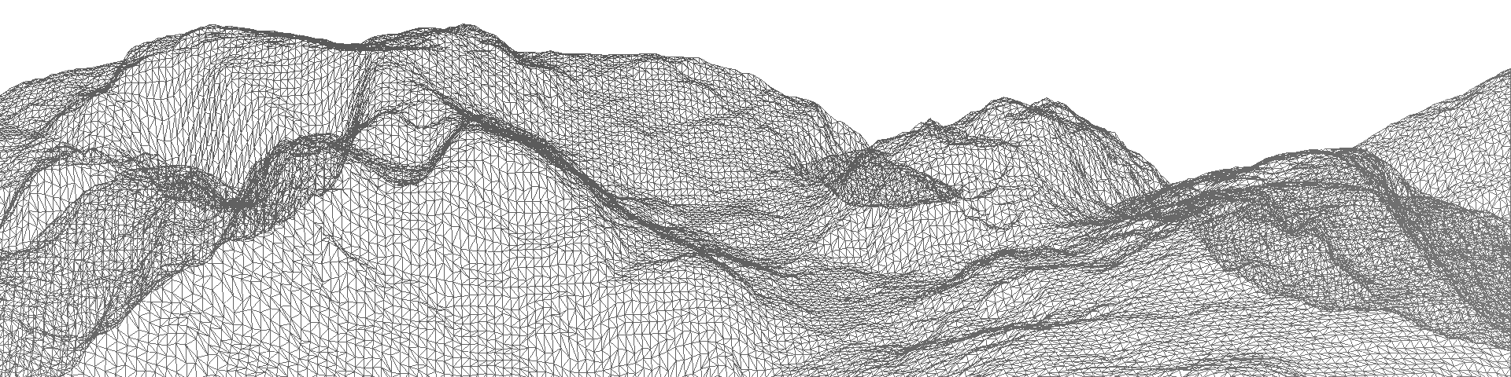
Numerical representation of OROGRAPHY in dynamical cores
Quo Vadis
James Shaw
Hilary Weller, John Methven, Terry Davies

Slide 2
Numerical representation of orography in dynamical cores
Meshes represent terrain and the air above it
Equations of motion are solved using numerical schemes

Slide 3
Numerical representation of orography in dynamical cores
Meshes represent terrain and the air above it
Equations of motion are solved using numerical schemes

Slide 4
The challenge
Atmospheric models are increasing in resolution
Higher resolution resolves steeper slopes in terrain
Steep slopes are challenging to represent without increasing numerical errors

Slide 5
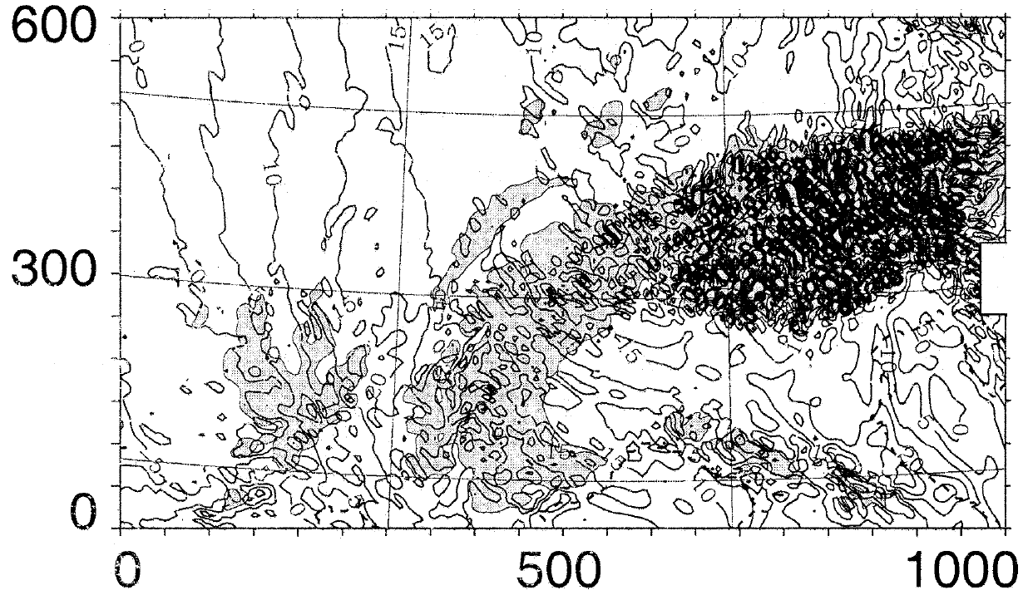
The challenge
MM5 relative vorticity at 250 hPa, contours every 5×10⁻⁵ s⁻¹
y (km)
x (km)
Hoinka and Zängl 2004, Mon. Wea. Rev.
Terrain above 800m

Slide 6
Outline
Meshes & numerical error
A new type of mesh
An improved advection scheme
A new advection test

Slide 7
#1 MESHES & Numerical Error

Slide 8
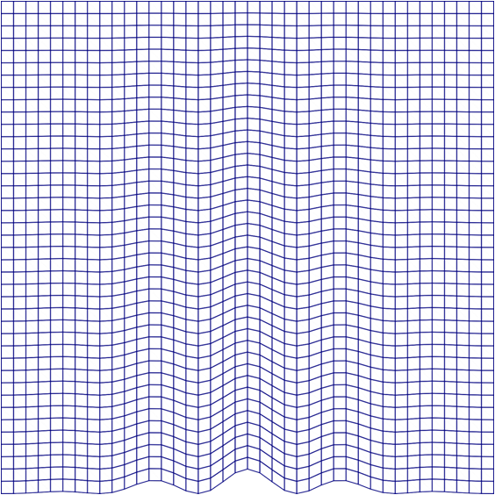
MESHES Basic Terrain Following
Gal-Chen and Somerville 1975, J. Comp. Phys.

Slide 9

MESHES Smooth Level Vertical
Schär et al. 2002, Mon. Wea. Rev.

Slide 10

MESHES Cut Cells
Adcroft et al. 1997, Mon. Wea. Rev.

Slide 11
Spurious circulation of a resting atmosphere
Idealised two-dimensional test from Klemp 2011, Mon. Wea. Rev.
Wave-shaped mountain
Stably stratified atmosphere
Initially at rest
Mesh distortions → pressure gradient errors → spurious circulation

Slide 12
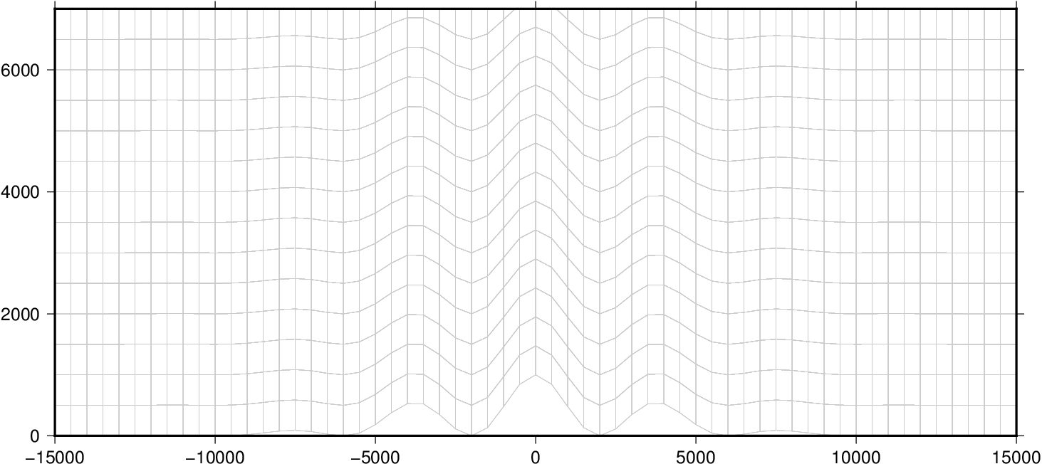
Spurious circulation of a resting atmosphere Basic terrain following
z (m)
x (m)

Slide 13
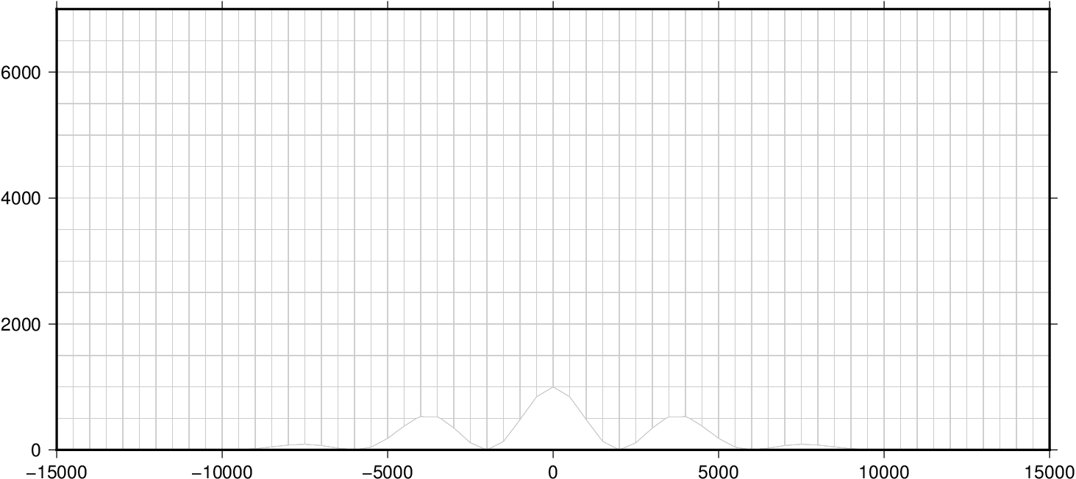
Spurious circulation of a resting atmosphere
Basic
Terrain
Following
Cut cell

Slide 14
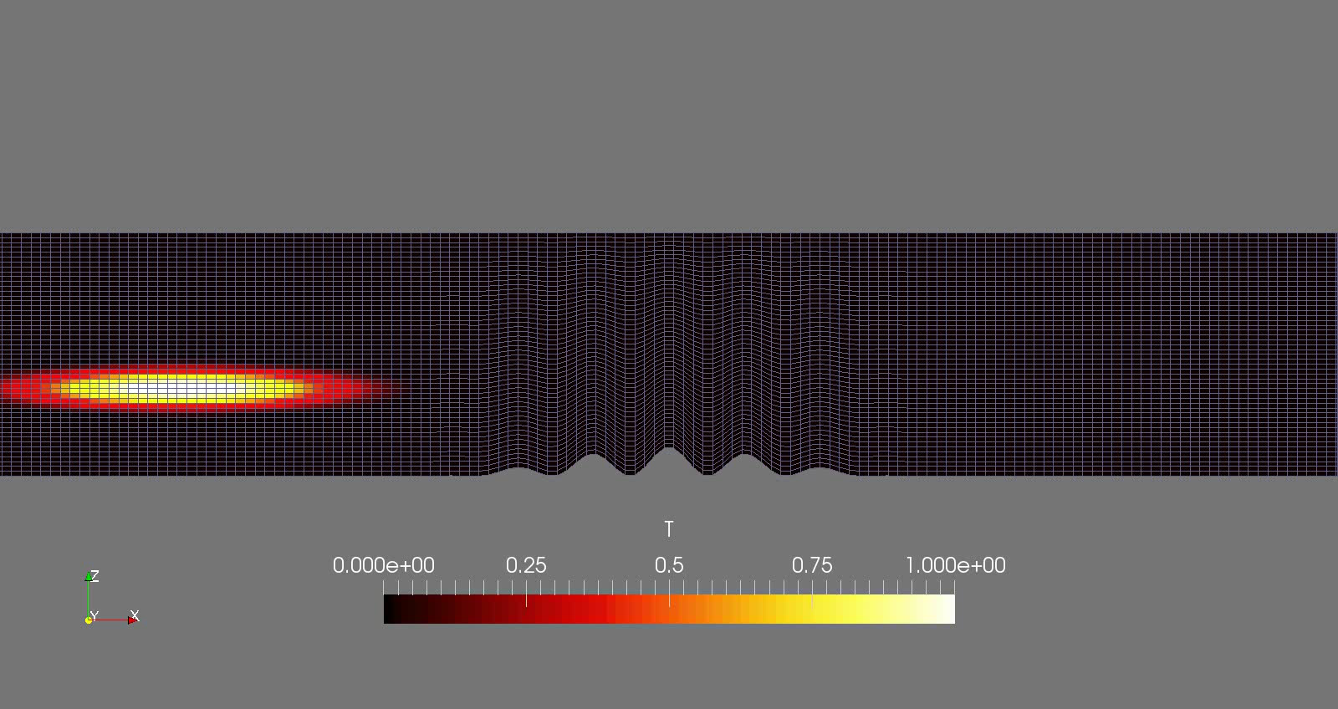
Horizontal Tracer advection Basic Terrain Following
Test case from Schär et al. 2002, Mon. Wea. Rev.

Slide 15

Horizontal Tracer advection Cut Cells
Test case from Schär et al. 2002, Mon. Wea. Rev.

Slide 16
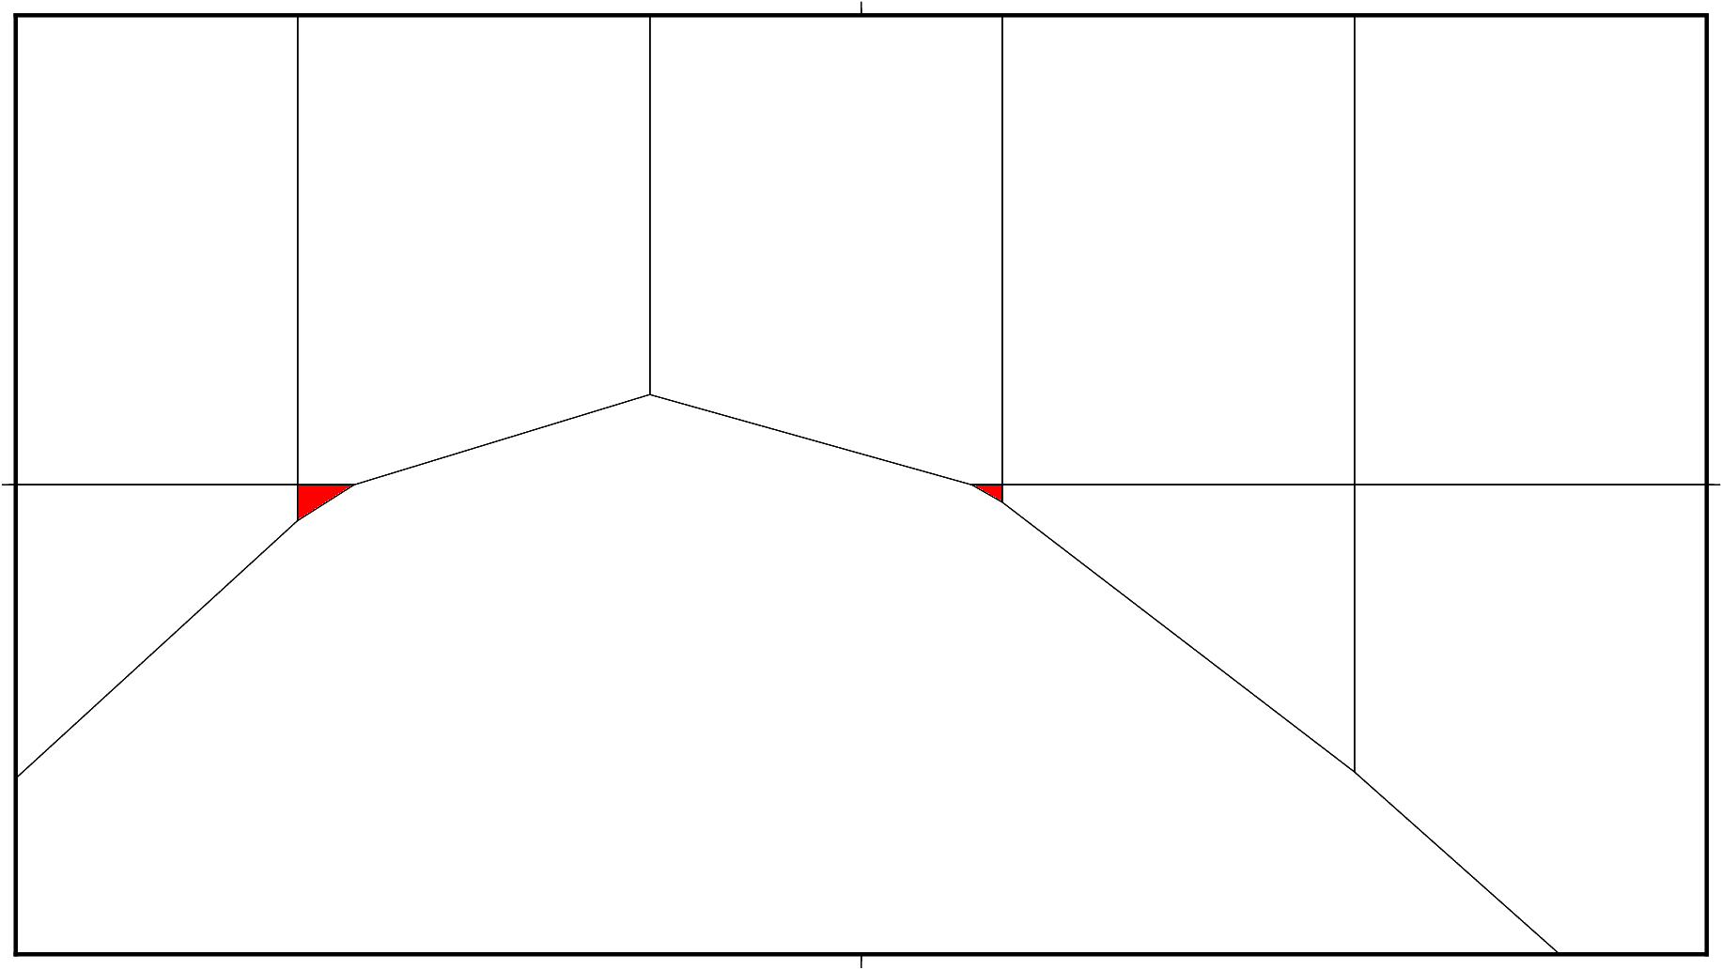
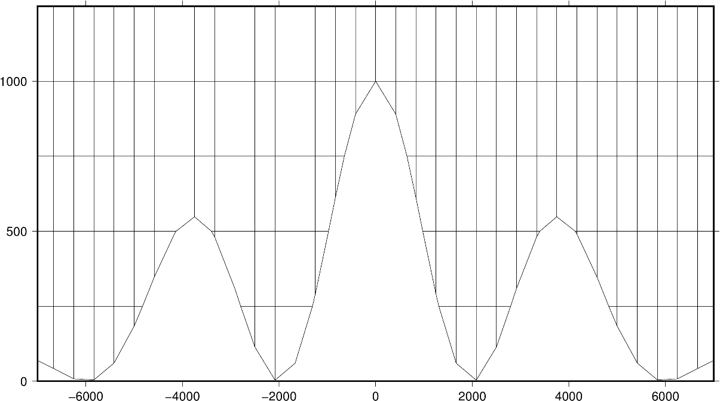
Cut Cell Mesh Small Cell problem

Slide 17
#2 A new type of mesh
Reduce pressure gradient errors
Reduce advection errors
Avoid small cell problem

Slide 18
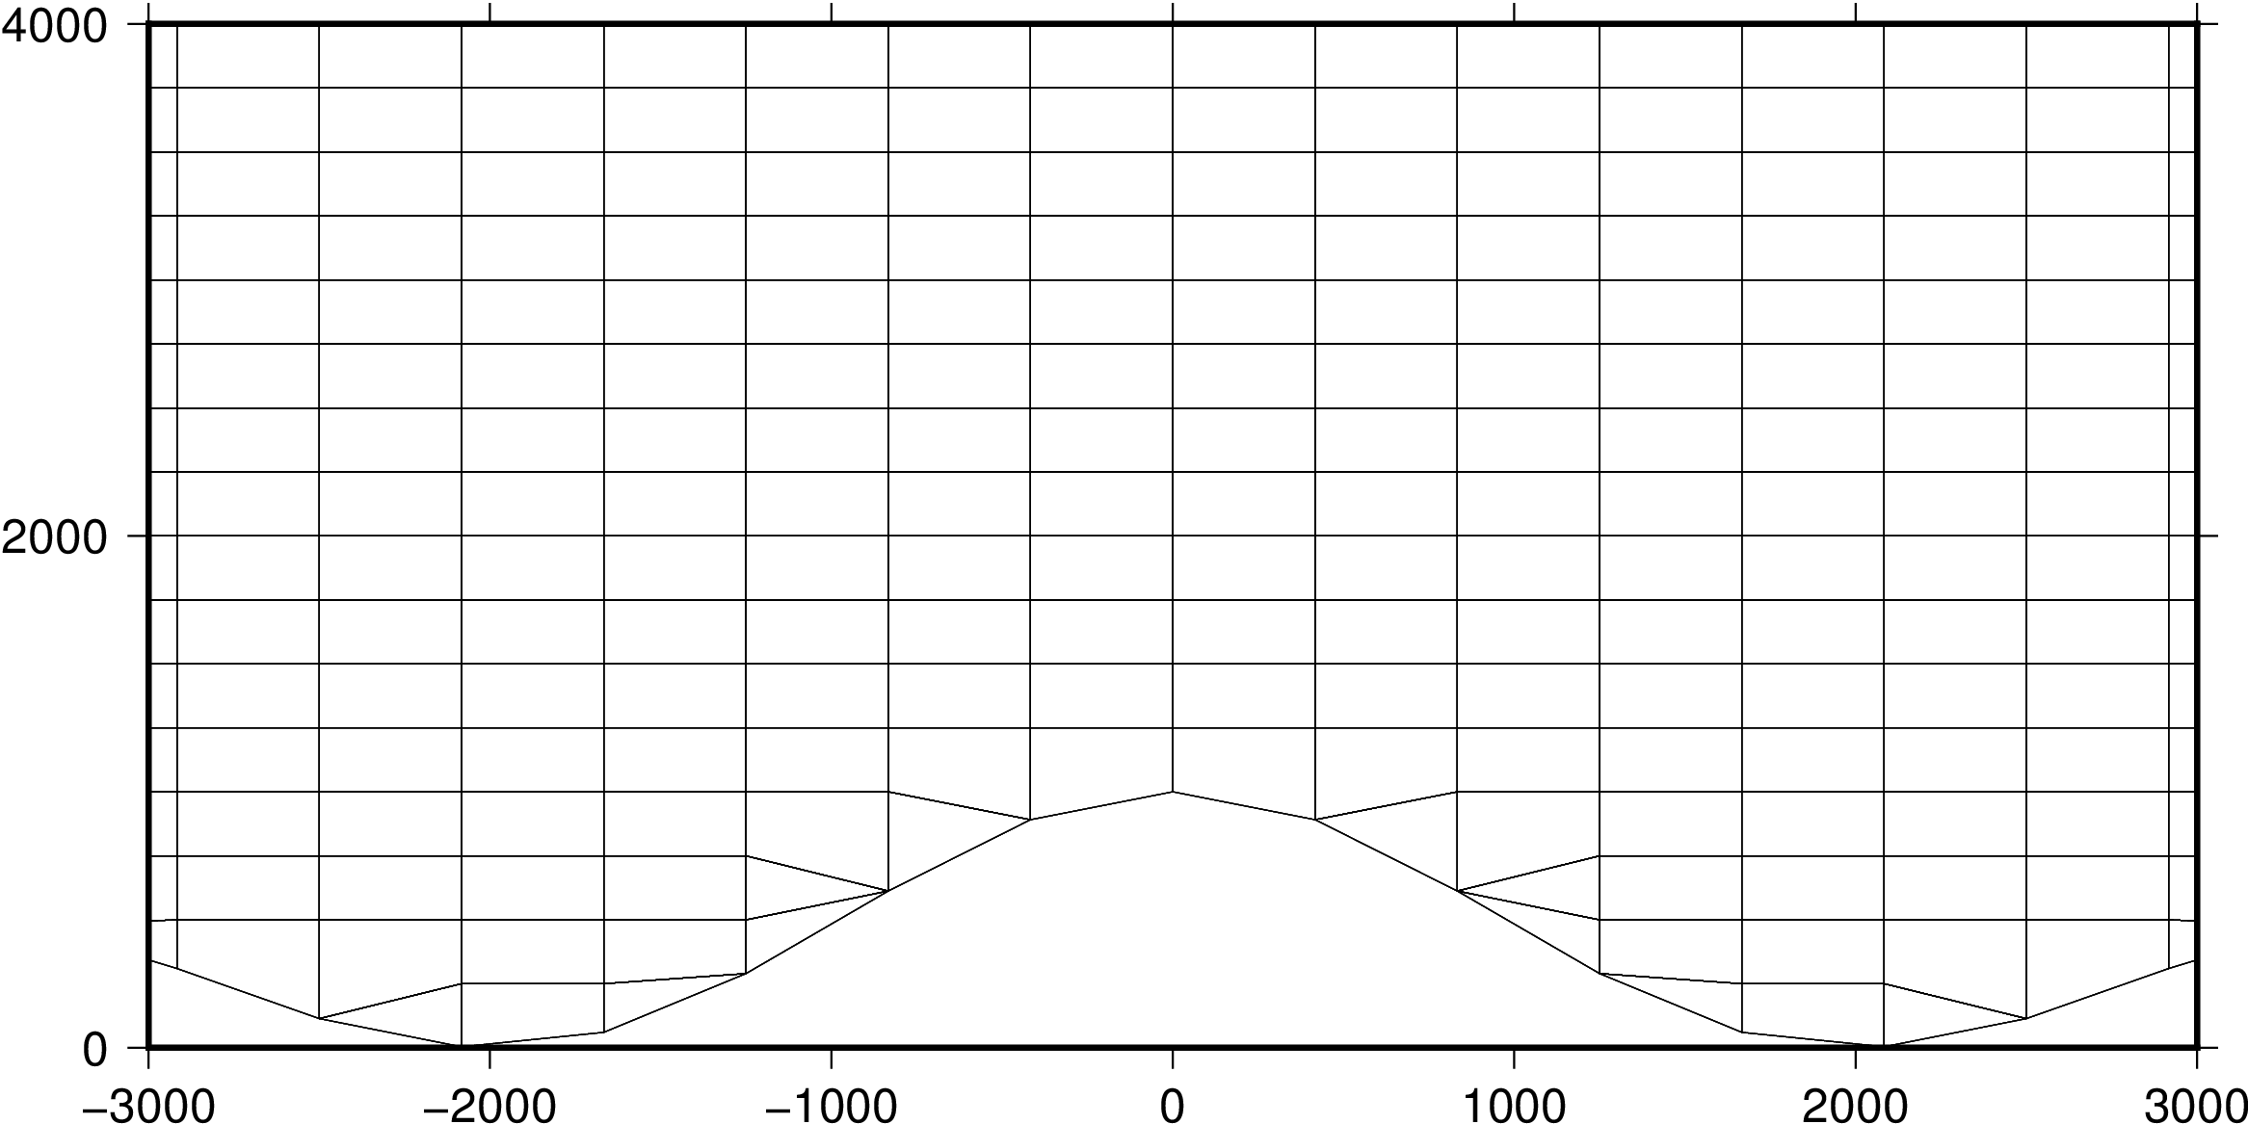
A new type of mesh
z (m)
x (m)

Slide 19
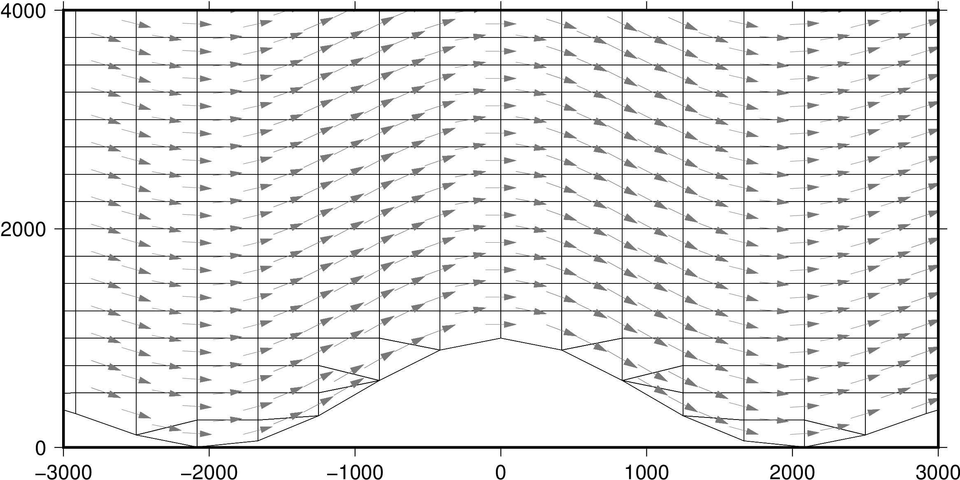
A new type of mesh
z (m)
x (m)

Slide 20
#3 An Improved advection scheme
Finite volume
Explicit
Eulerian
Flux form → approximate values at faces

Slide 21
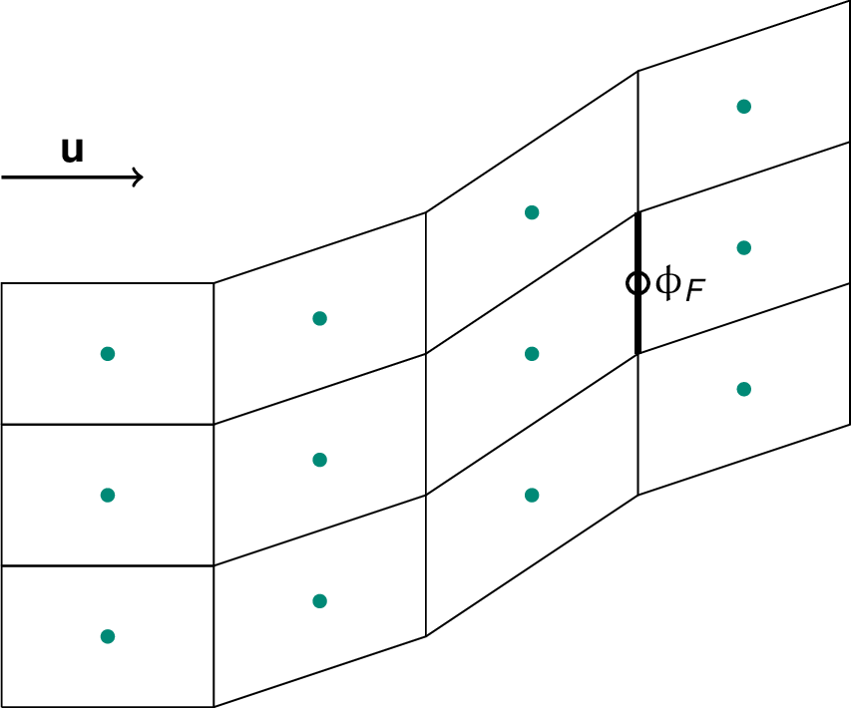
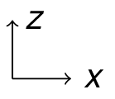
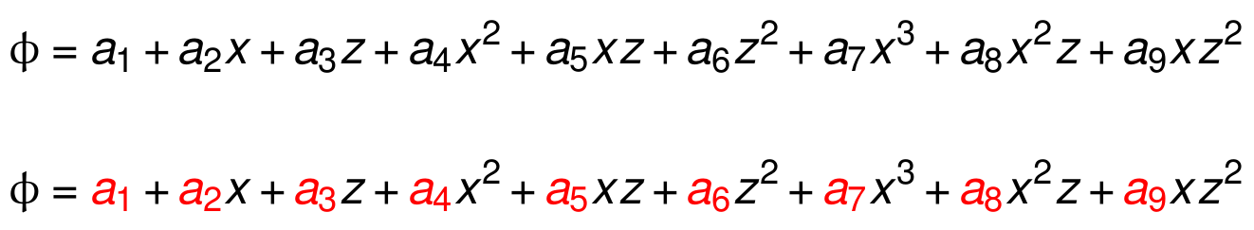
An improved advection scheme

Slide 22
An improved advection scheme
12 known values
9 unknown coefficients

Slide 23
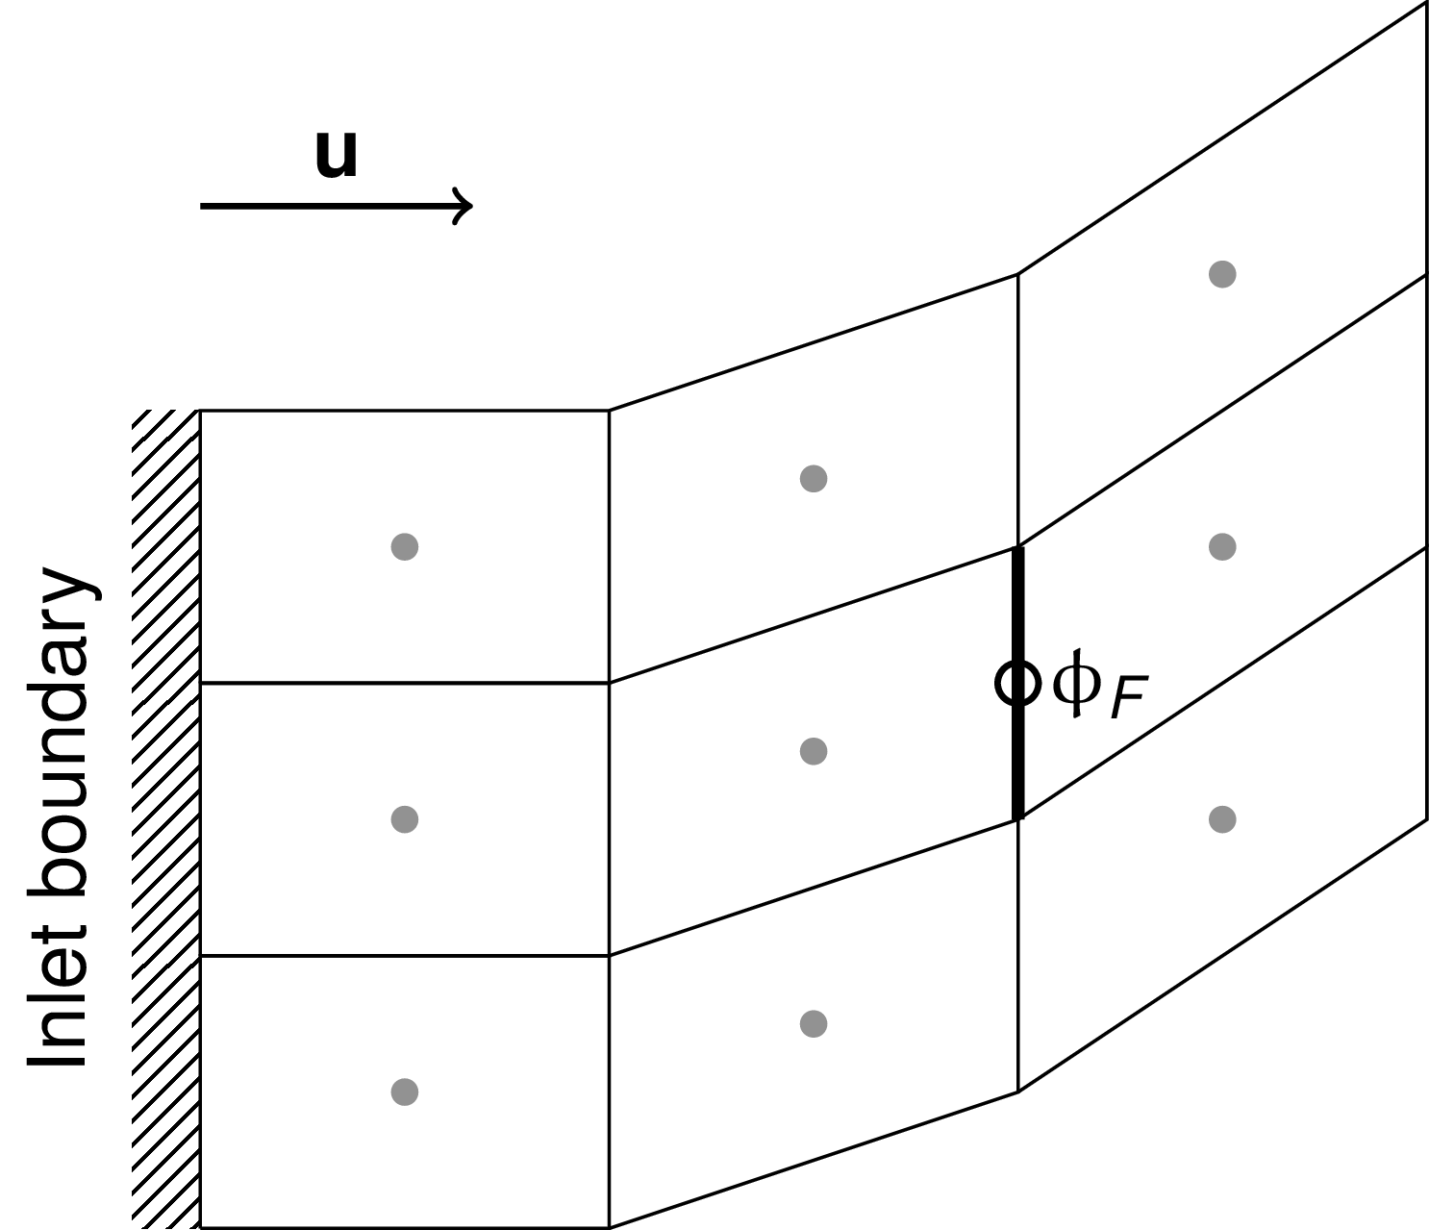
An improved advection scheme
9 known values
9 unknown coefficients

Slide 24
An improved advection scheme
✕

Slide 25
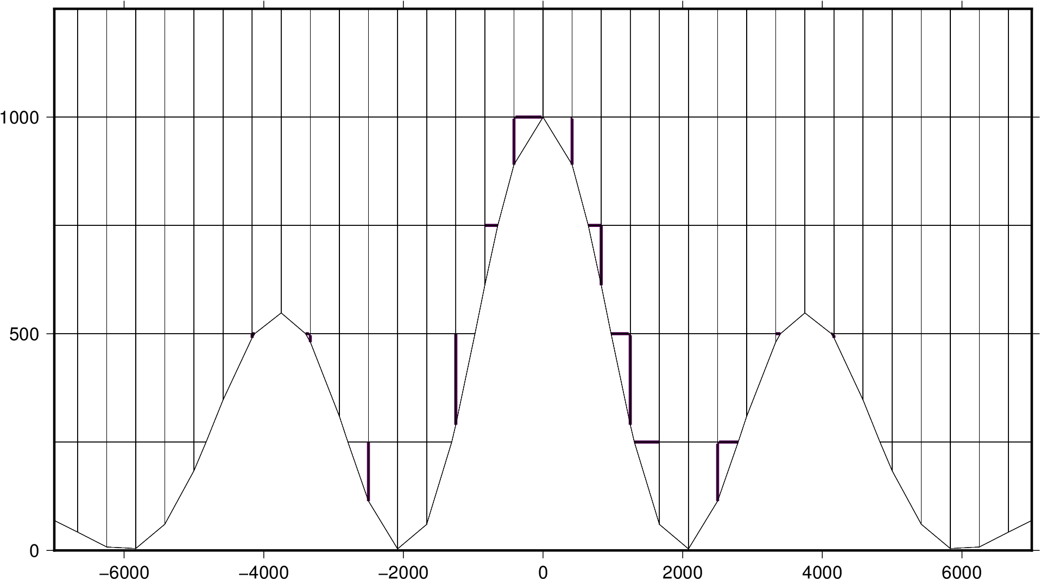
An improved advection scheme
z (m)
x (m)

Slide 26
#4 A new advection test
Mimics real thermal flow
Challenges advection above lower boundary
Analytic solution → calculation of numerical errors

Slide 27
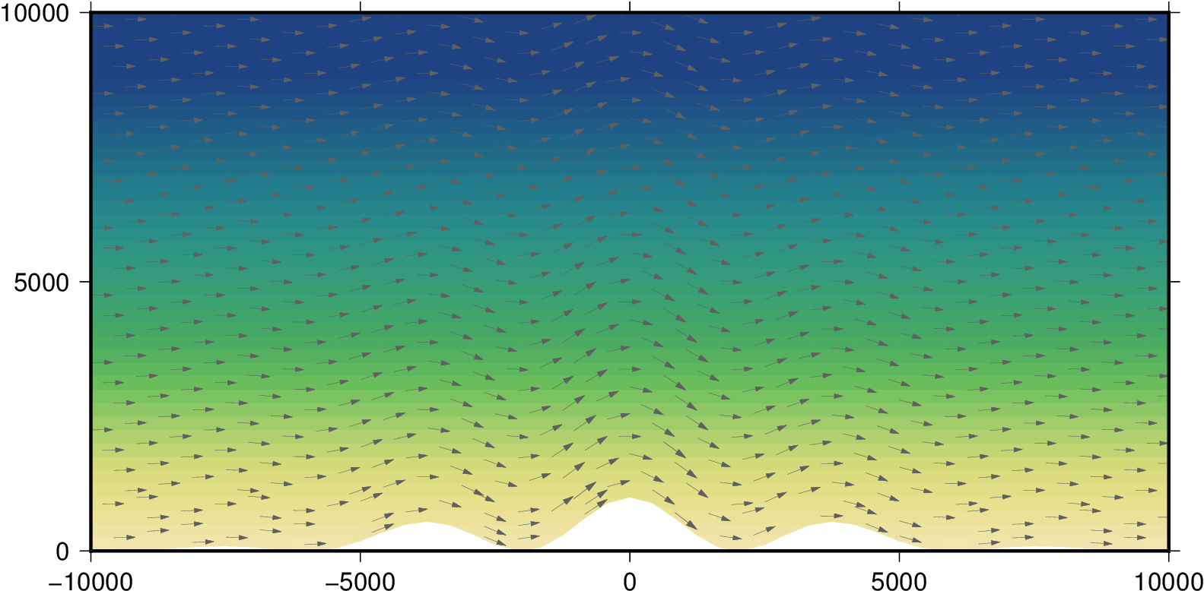
Advection test initial conditions
Initial, stably stratified potential temperature field
Prescribe a fixed, terrain-following wind field
z (m)
x (m)
θ (K)

Slide 28
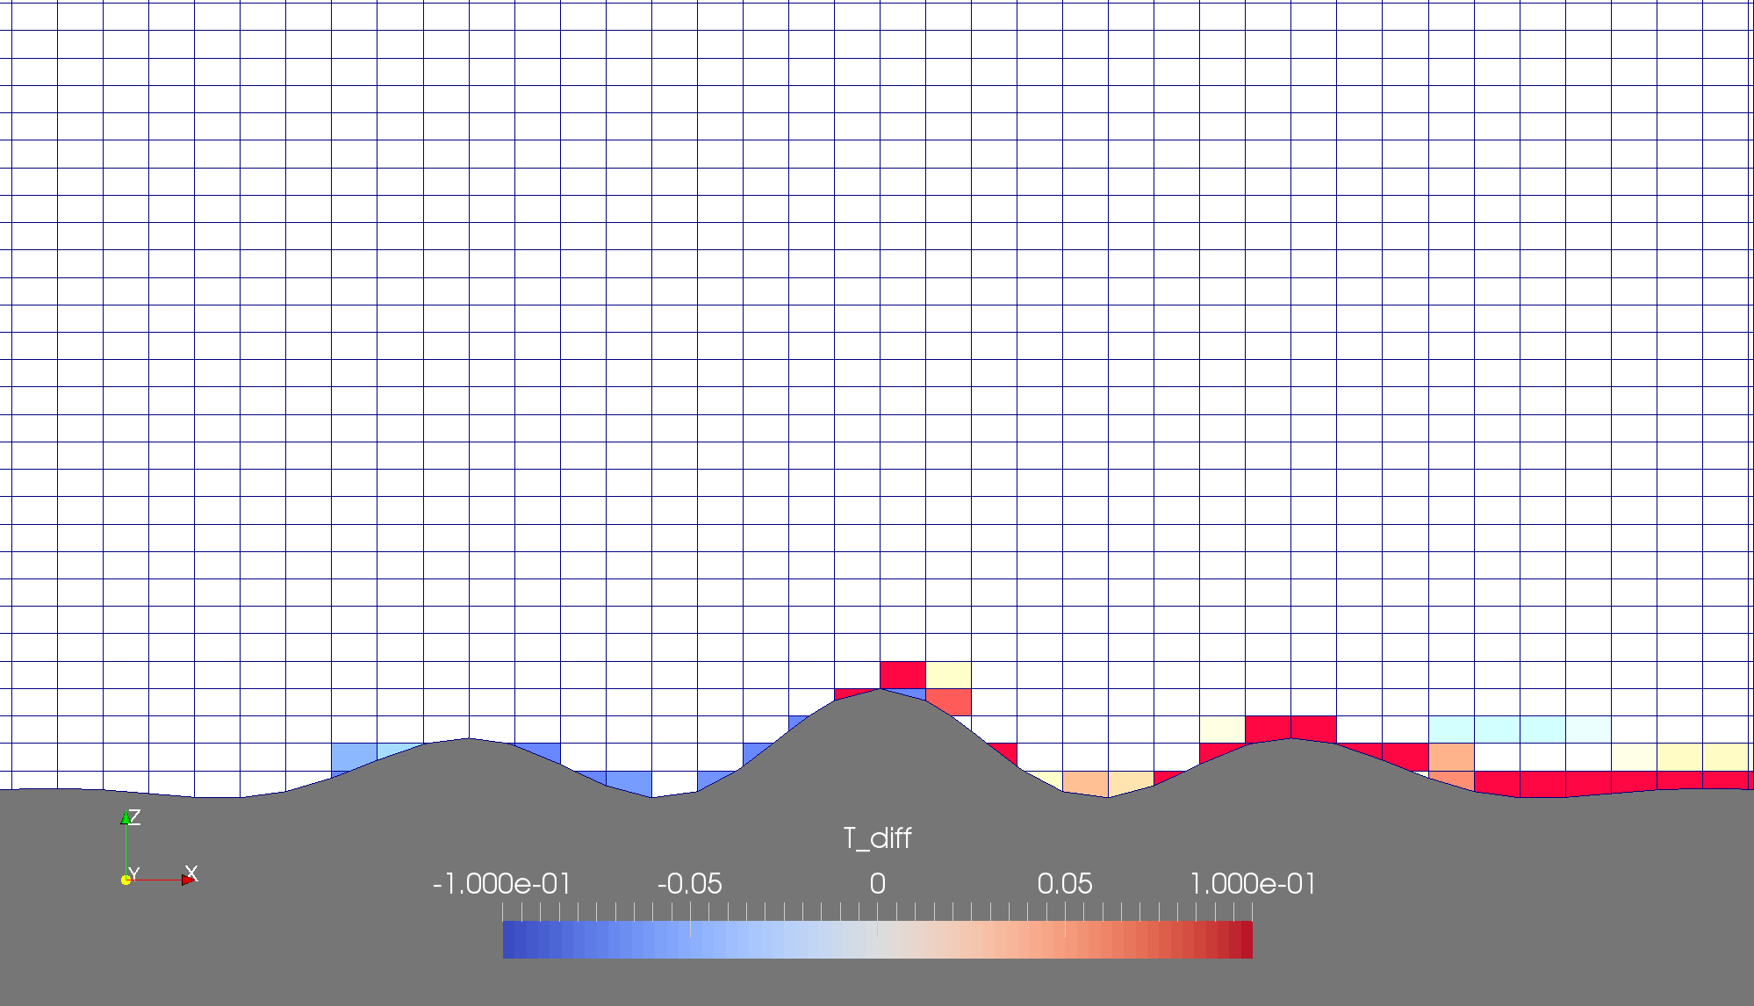
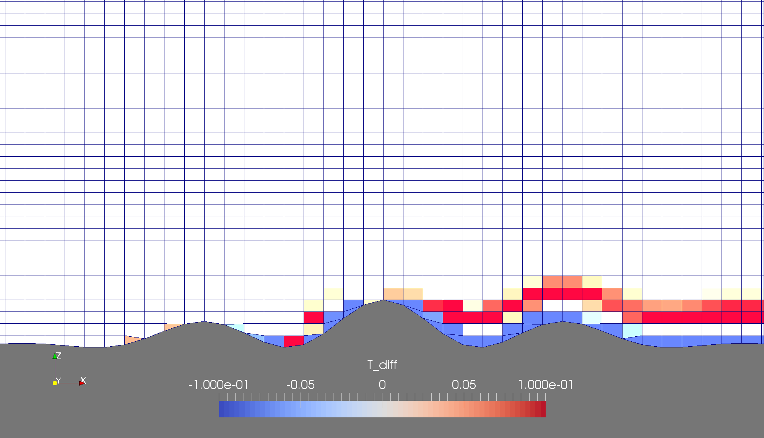
Advection test errors
Cut cells — Fixed polynomial fit
Slanted cells — Fixed Polynomial fit

Slide 29
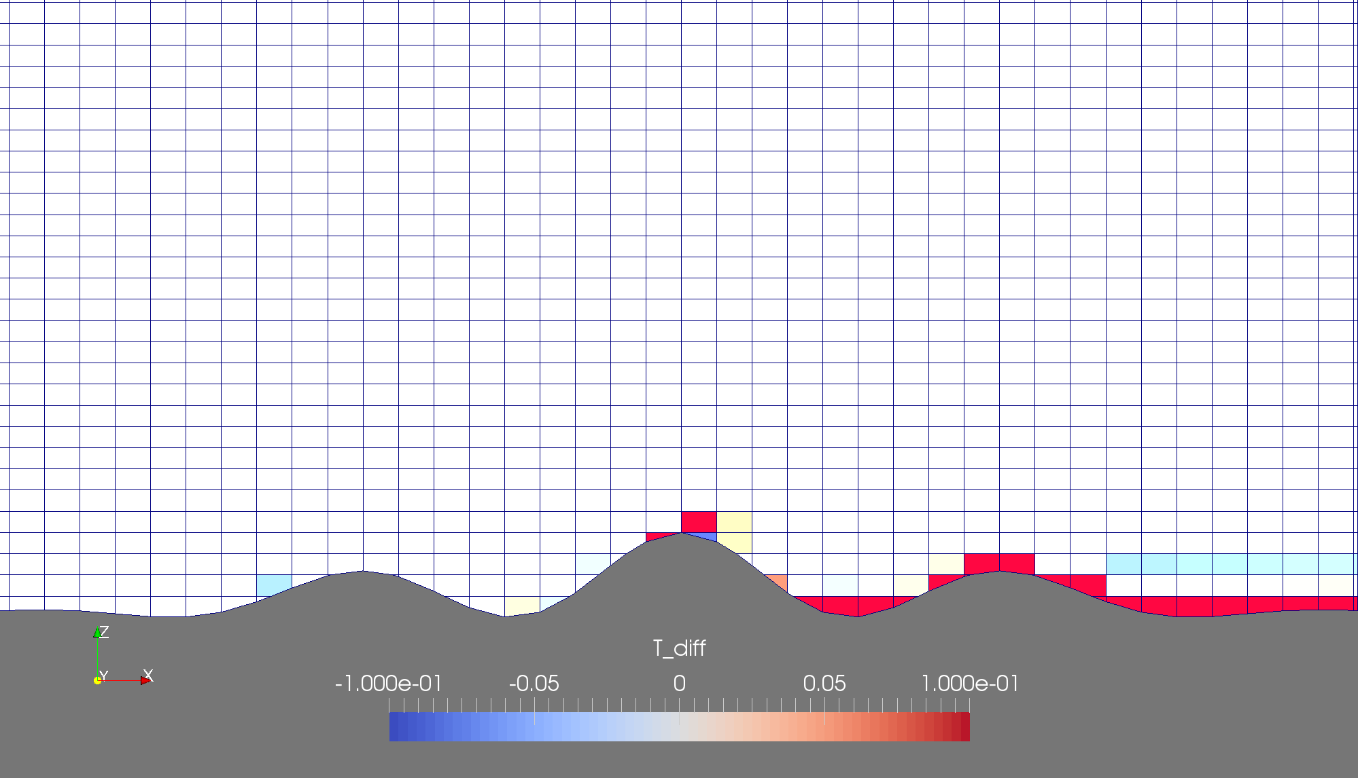
Advection test errors
Cut cells — Adaptive polynomial fit
Cut cells — Fixed Polynomial fit

Slide 30
Advection test errors
Cut cells — Adaptive polynomial fit
Cut cells — Fixed Polynomial fit

Slide 31
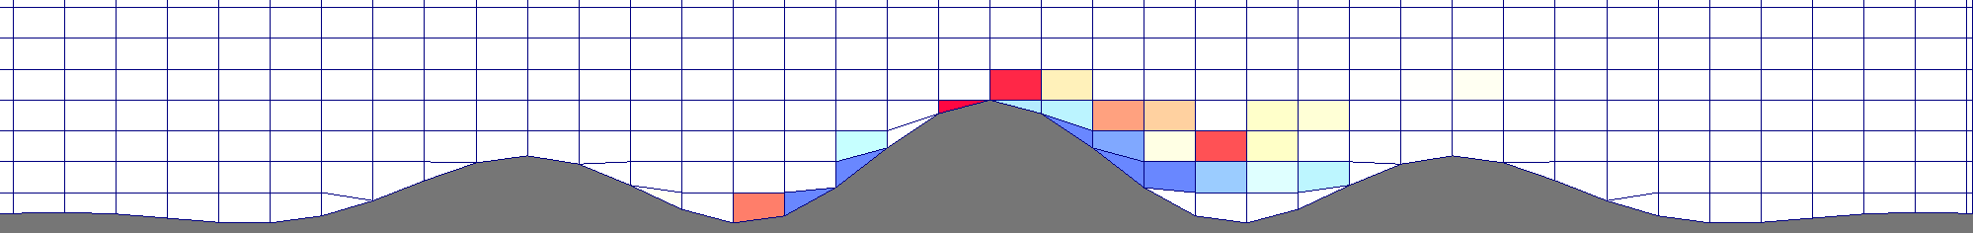
Advection test errors
Slanted cells — Adaptive polynomial fit
Slanted cells — Fixed Polynomial fit
Cut cells — Adaptive polynomial fit

Slide 32
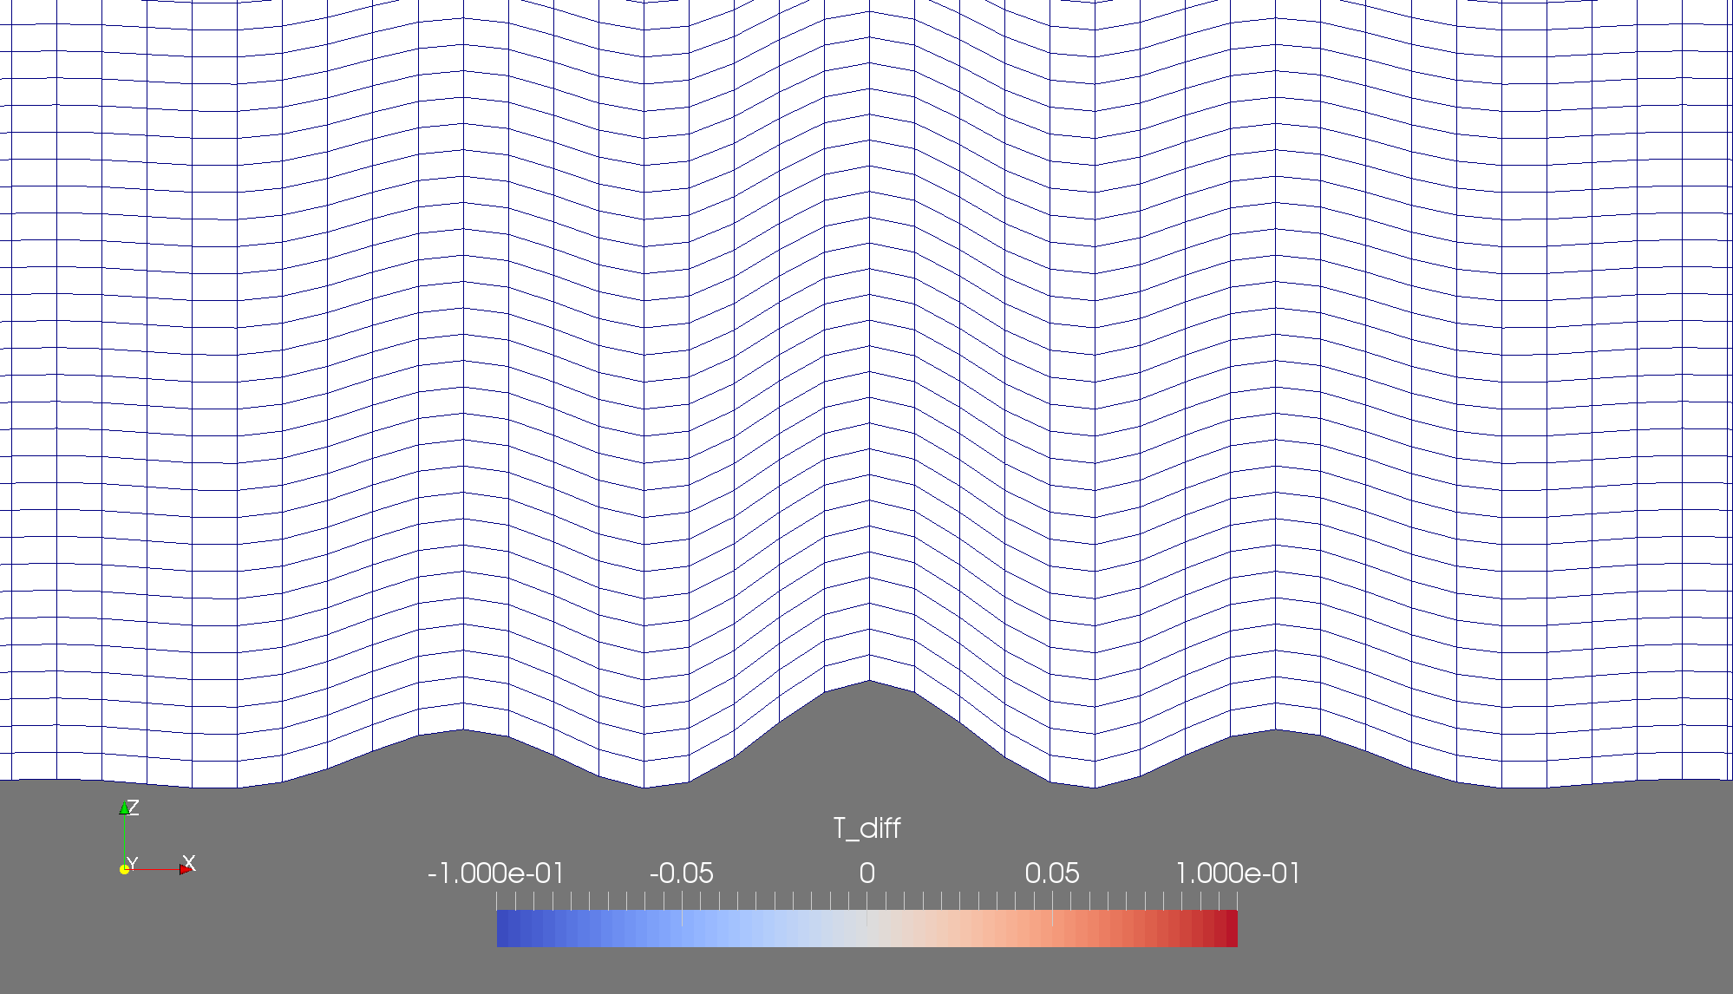
Advection test errors
Basic terrain following — Fixed polynomial fit

Slide 33

Spurious circulation of a resting atmosphere
Slanted Cell
Cut cell

Slide 34
ConcLUSIONS
Slanted cells alleviate small cell problem
Slanted cells reduce pressure gradient errors
Adaptive polynomial fit improves accuracy
Advection stability and accuracy using von Neumann analysis
New thermal advection schemes for a dynamical core suitable for arbitrary meshes
Next steps

Slide 35
Extra slides

Slide 36

MESHES Hybrid Terrain Following

Slide 37
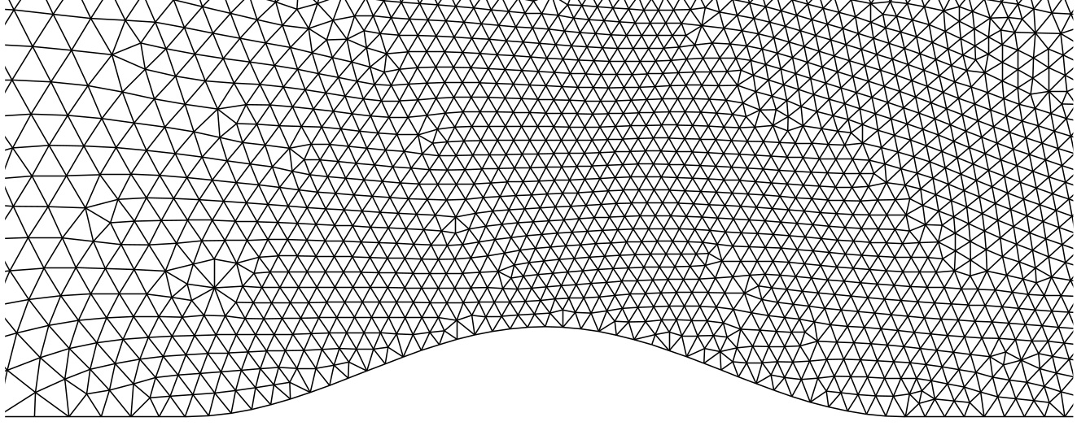
MESHES And Others
Source: Smolarkiewicz & Szmelter
http://ral.ucar.edu/hap/events/orographic-precip/images/2wed/am/day2-Wed_am_3-Orogunmesh2.ppt

Slide 38
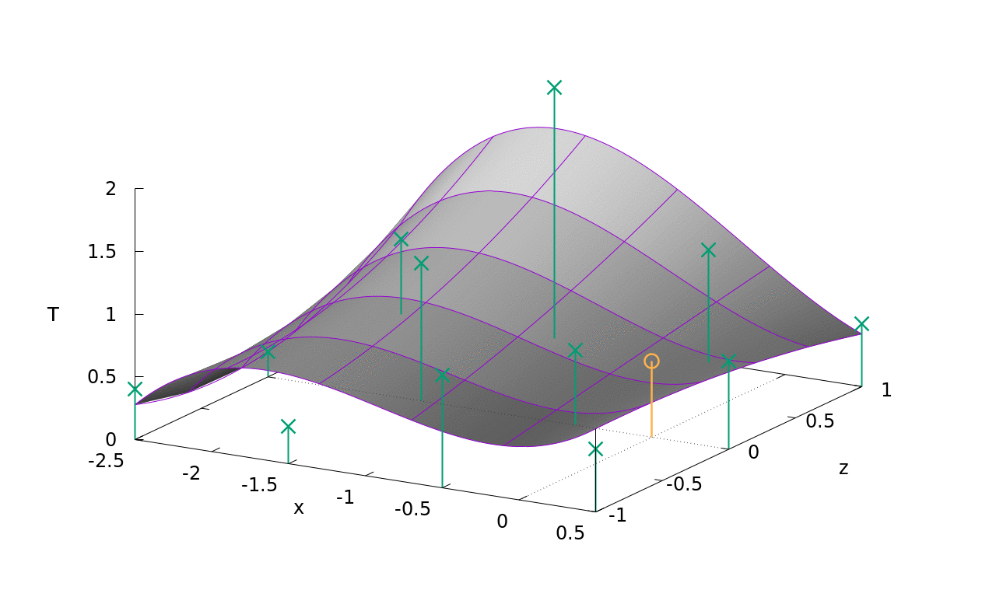
An improved advection scheme

Slide 39
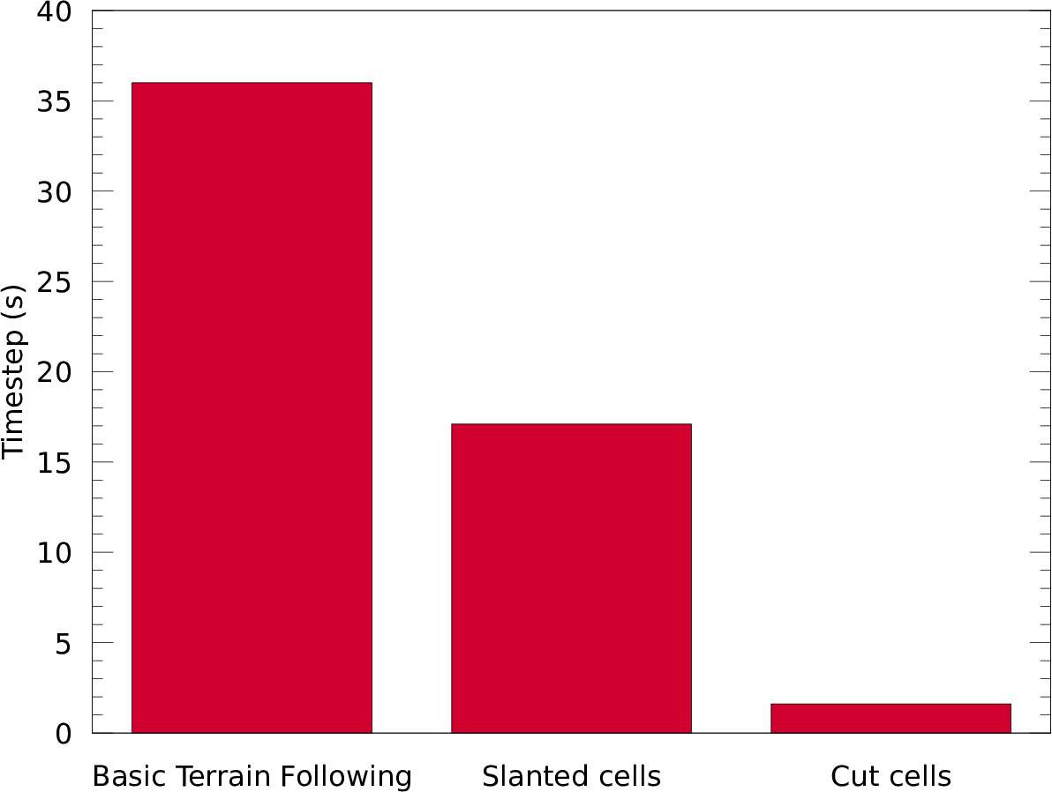
A new advection test
Max Courant number 0.9 – 1.0

Slide 40
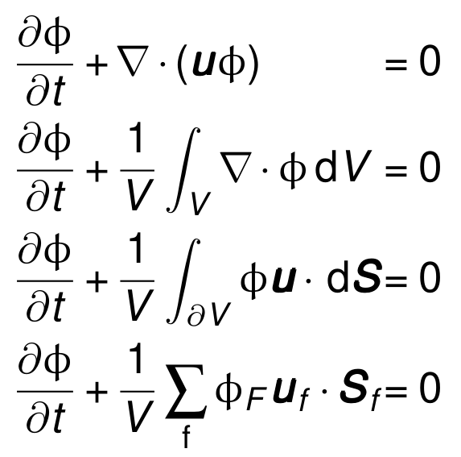
An improved advection scheme

Slide 41
An improved advection scheme

Slide 42
An improved advection scheme

Slide 43
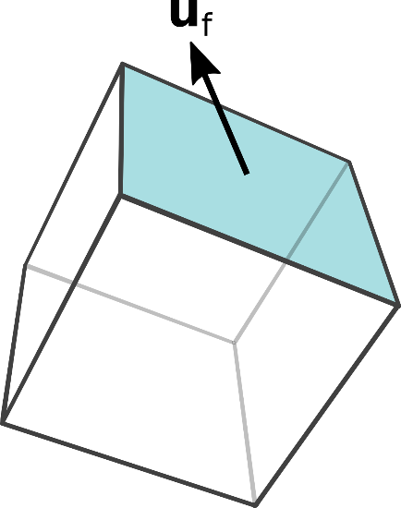
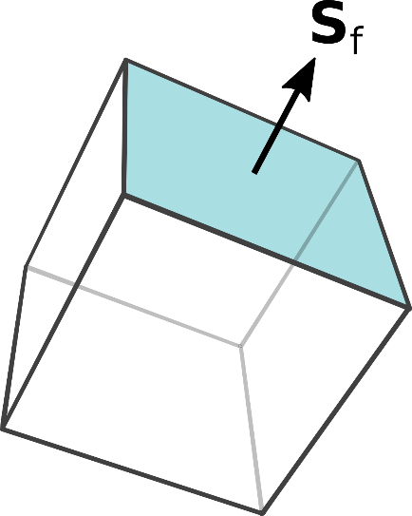
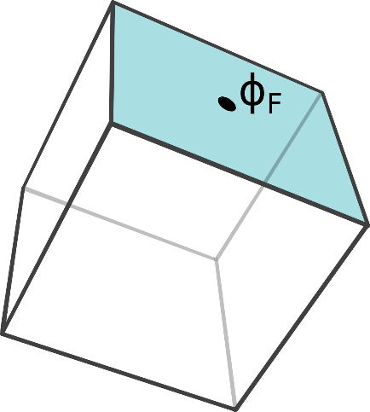
An improved advection scheme
Adapted from User:DTR - Vectorisation of Image:Hexahedron.jpg, CC BY-SA 3.0, https://commons.wikimedia.org/w/index.php?curid=2231470

Slide 44
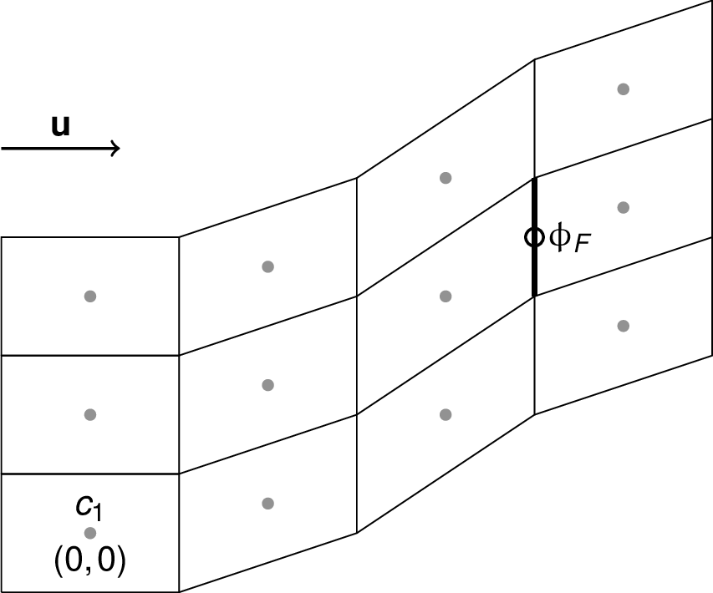
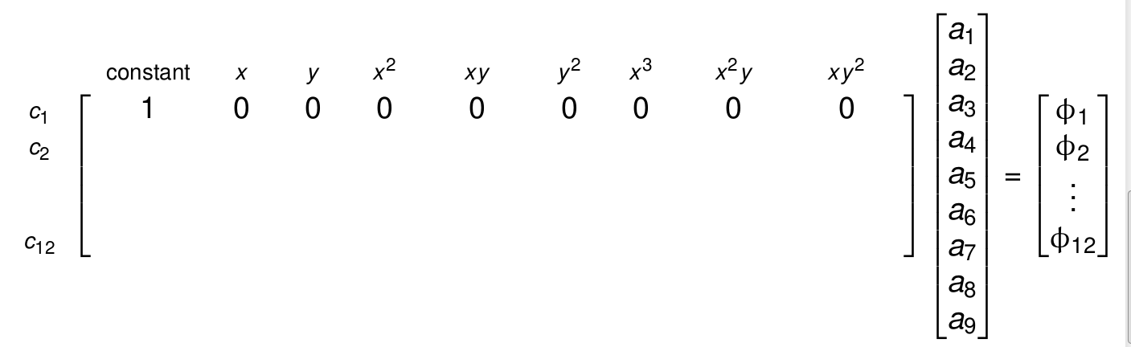

Slide 45
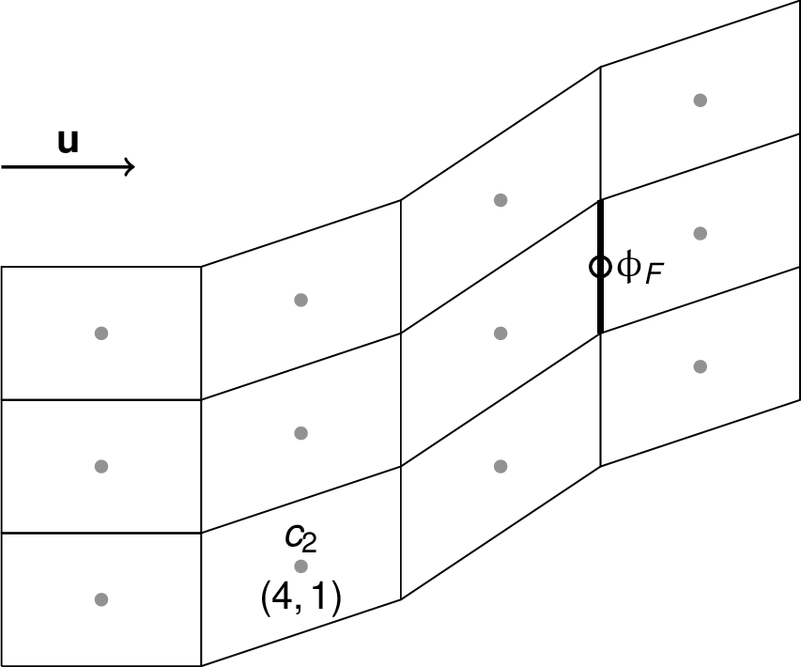
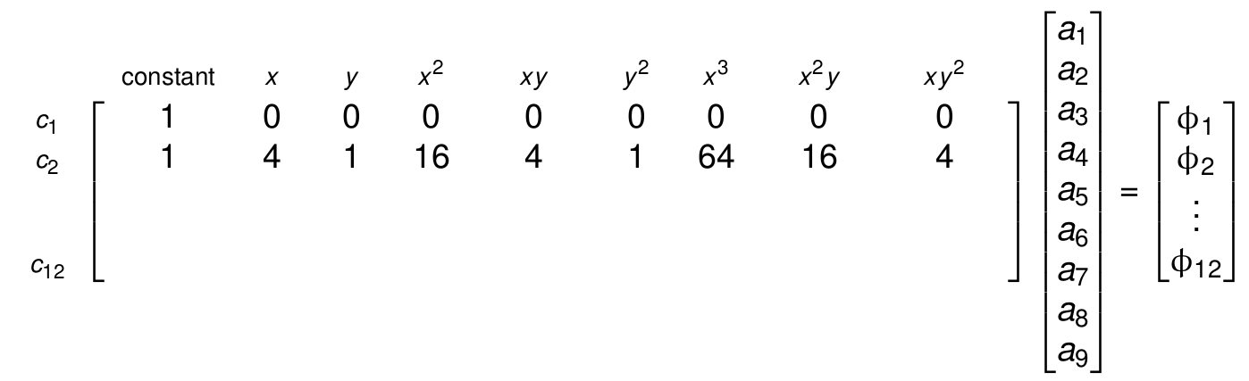

Slide 46
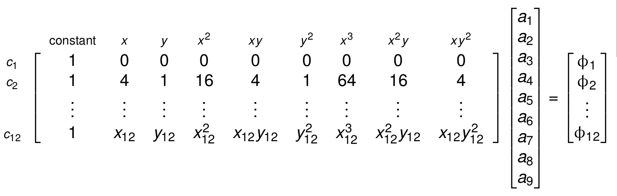

Slide 47
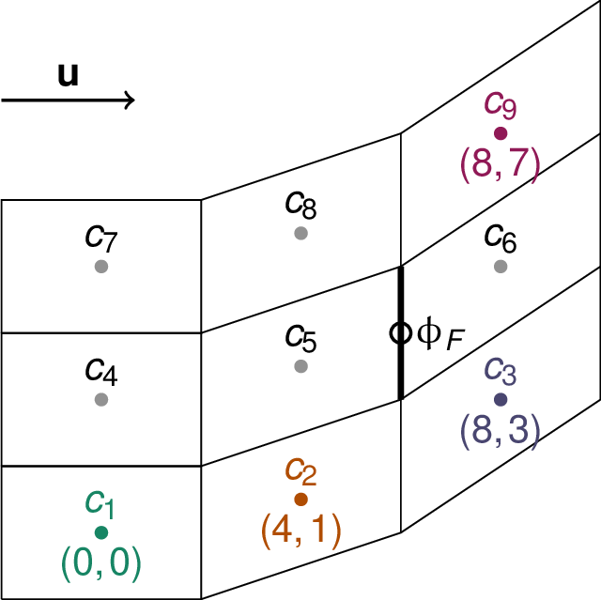
An improved advection scheme

Slide 48
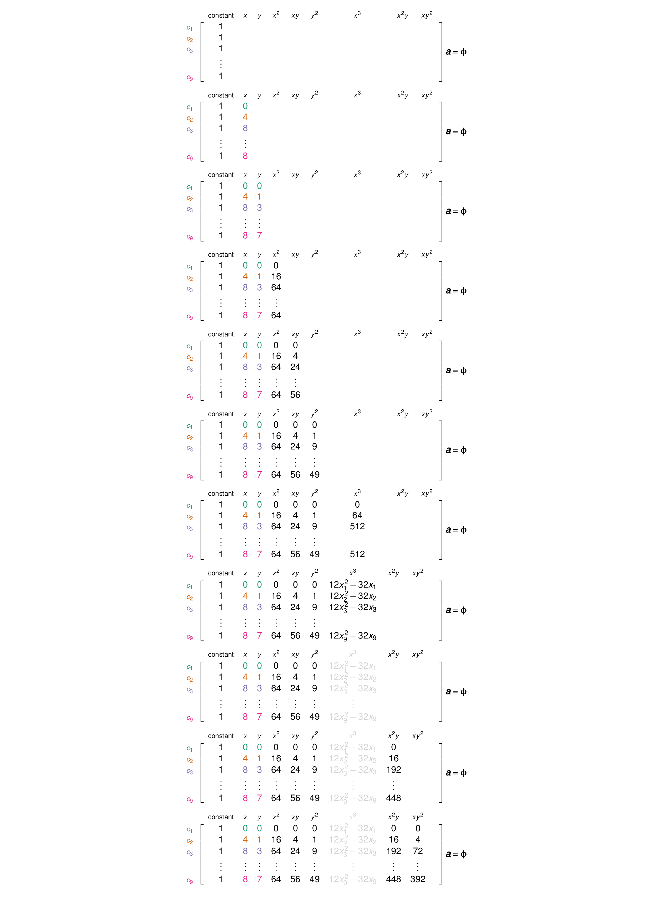
An improved advection scheme

Slide 49
An improved advection scheme

Slide 50
An improved advection scheme

Slide 51
An improved advection scheme

Slide 52
An improved advection scheme

Slide 53
An improved advection scheme

Slide 54
An improved advection scheme

Slide 55
An improved advection scheme

Slide 56
An improved advection scheme

Slide 57
An improved advection scheme

Slide 58
An improved advection scheme

